Slide 1

Pitch Deck
PRESENTATION
Fauget Inc.
Alfredo Torres
hello@reallygreatsite.com

Slide 2
01
02
03
Problem 1
Problem 2
Problem 3
Give a striking overview of the problem and explain it briefly.
Elaborate on how this negatively impacts people and their experiences.
Frame the problems effectively as it will set the stage of your entire pitch.

Slide 3
Key
Features
Feature 1
Visualize your competitive advantages using a quadrant for easy scanning.
Feature 2
Feature 3
Feature 4
How is the landscape differentiated and what makes you different.
How is the landscape differentiated and what makes you different.
What can you do better than your competition? How will you outperform them?

Slide 4

Solution 1
01
Describe how you envision to solve the problems you previously shared.
Solution 2
02
Describe how you envision to solve the problems you previously shared.
Solution 3
Fauget Inc.
03
Describe how you envision to solve the problems you previously shared.

Slide 5



Target User
User 1
User 2
User 3
Give a striking overview of the problem and explain it briefly.
Elaborate on how this negatively impacts people and their experiences.
Frame the problems effectively as it will set the stage of your entire pitch.

Slide 6




Competitive Analysis
Your main Competitors and their products, how are they different and what value do you provide to your customers?
Give a striking overview of the problem and explain it briefly.
Give a striking overview of the problem and explain it briefly.
Give a striking overview of the problem and explain it briefly.
Give a striking overview of the problem and explain it briefly.

Slide 7
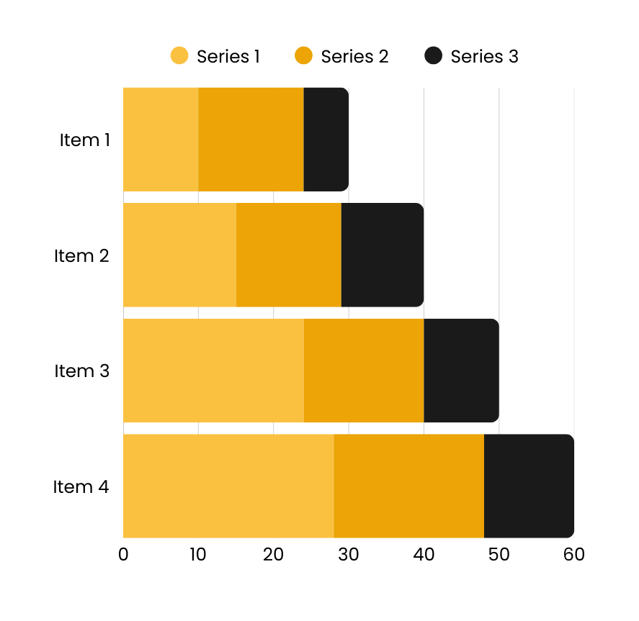
Insight 1
01
Describe how you envision to solve the problems you previously shared.
Insight 2
02
Describe how you envision to solve the problems you previously shared.
Insight 3
03
Describe how you envision to solve the problems you previously shared.

Slide 8

Elegant
01
Describe how you envision to solve the problems you previously shared.
Stylish
02
Describe how you envision to solve the problems you previously shared.
Attractive
03
Describe how you envision to solve the problems you previously shared.

Slide 9



Future Roadmap
What are your next steps and goals? How much support do you need from investors and what will it get you?
Prototype
Launch
V2.0
V2.2
Q1 2022
Q2 2022
Q3 2022
Q4 2022

Slide 10
Thank You
FOR YOUR TIME
Fauget Inc.
Alfredo Torres
hello@reallygreatsite.com

